Slide 1

Android Development Workshop
by Eric Castro
ercastro

Slide 2

Overview
Activities
Layouts
Listeners
Saving Data

Slide 3
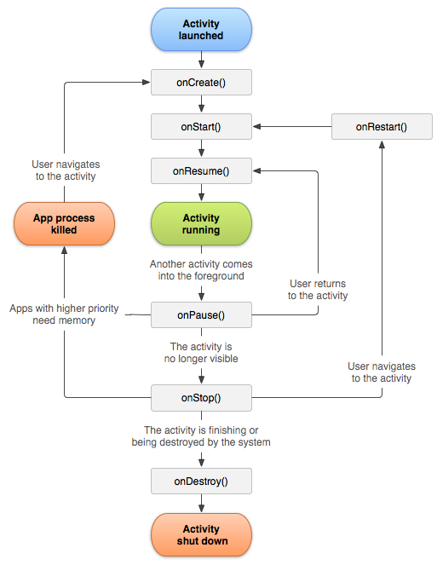
Activities
“App Lifecycle”
“Page” of the application
Ability to Override each function
http://developer.android.com/guide/components/activities.html

Slide 4
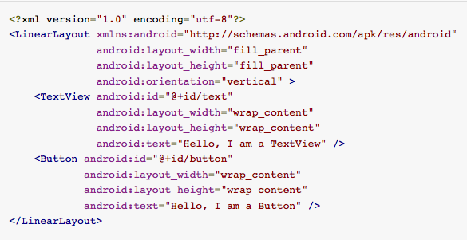
Layouts
Declare UI elements in XML
Can be done programmatically
Connections made in activities
Types of layouts
LinearLayout (Horizontal/Vertical)
RelativeLayout
GridLayout
FrameLayout
http://developer.android.com/guide/topics/ui/declaring-layout.html

Slide 5
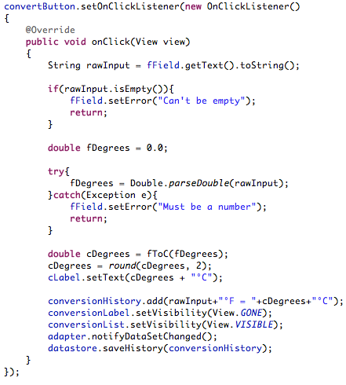
Listeners
“Listen” for user input action
Button Click
OnClickListener
Item Click
OnItemClickListener
Long Click
OnItemLongClick
Touch Listeners
Etc.

Slide 6
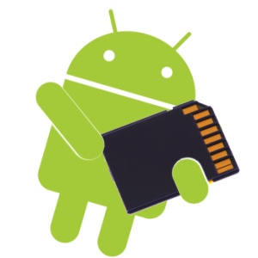
Data Storage Options
Saving Data
Shared Preferences
Preferred method
Not fit for sensitive information
Internal Storage
Device memory
Can be simple with Java’s Serialization
Good for things like game saves
External Storage
External storage
Good for media (Images / Video)
SQLite Databases
Internal private database
Network Connection
Web Server
http://developer.android.com/guide/topics/data/data-storage.html

Slide 7

Let’s get started
https://github.com/ericcastro92/Temp-Converter-Example

